Slide 1
Predictive Data Mining
By
Divya Dongala
Pragati Gupta
Data Mining Project

Slide 2
Supervised learning
100%
Dataset
20%
Training Set
80%
Test Set
Data Mining by Divya and Pragati
2

Slide 3
Predictive Data mining
Regression analysis
Linear and multiple regression
Non-linear regression
Other regression methods:
Generalized linear model,
Log-linear models,
Regression trees
Classification
Linear Classifiers
Logistic regression
Naive Bayes classifier
Fisher’s linear discriminant
Support vector machines
Least squares support vector machines
Quadratic classifiers
Kernel estimation
k-nearest neighbour
Decision trees
Random forests
Neural networks
Learning vector quantization

Slide 4
Predictive Data mining
Predictor variables and a dependent or response variable
Linear regression:
Linear regression: involves a response variable y and a single predictor variable x y = w0 + w1 x
Regression coefficients:
where
w0 (y-intercept) and
w1 (slope) are

Slide 5
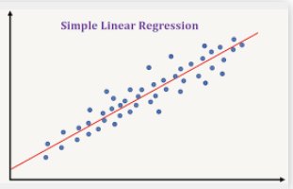
linear models
In linear regression, the relationships are modeled using linear predictor functions whose unknown model parameters are estimated from the data. Such models are called linear models.

Slide 6
Data Set (pre-processed)
IntroDuction Of data Set
The Data set of USA Housing. To predict the values of house.
DataSet
Row: 5001
Column: Avg_Area_Income
Avg_Area_House_Age Avg_Area_Number_of_Rooms Avg_Area_Number_of_Bedrooms Area_Population Price Address

Slide 7
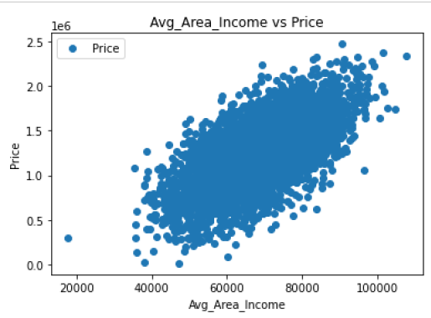
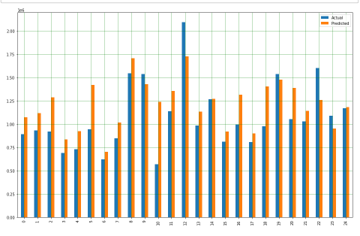
Case1: Income And Housing price
Based on “Avg_Area_Income” of the people linear regression performed to predict the value of houses.
Platform: Jupiter Notebook
Data Set: csv file
Language: python,( Panda, NumPy ).
Other Libraries:matplotlib.pyplot,seaborn, sklearn.model_selection,sklearn.linear_model,sklearn
X= Avg_Area_Income
Y= houses Price
Training set =20% of the dataset
Testing set =80% of the dataset
Step 1: Trained the data set and get the intercept.
Step2: Use the test data set to predict the house prices.
Step3: Compare the Actual values with the predicted values
and plot a bar graph.

Slide 8
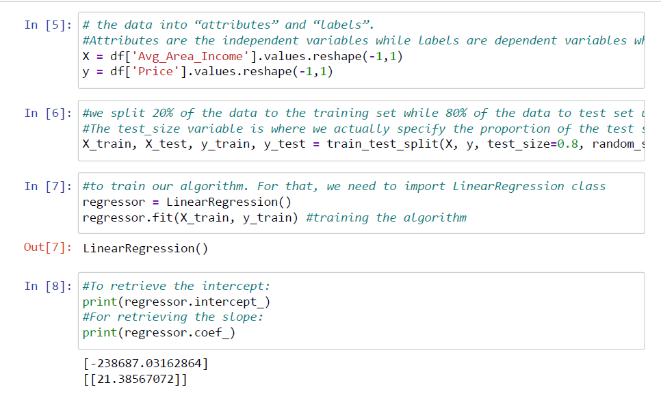
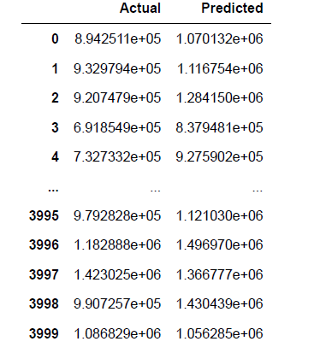
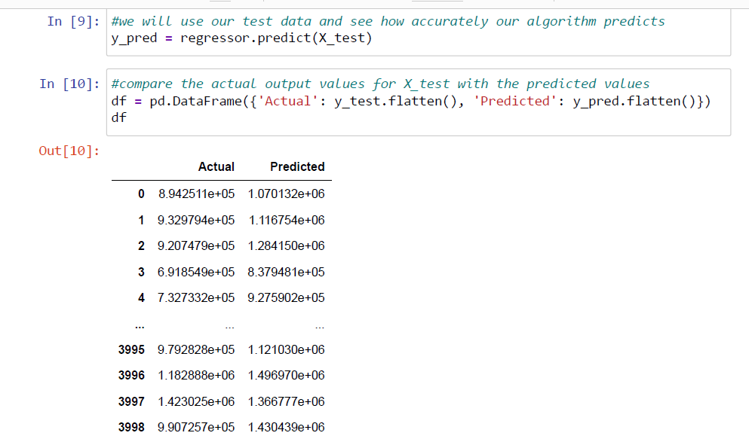
Case1: Income And Housing price
Demo of the tool with inputs and outputs.

Slide 9
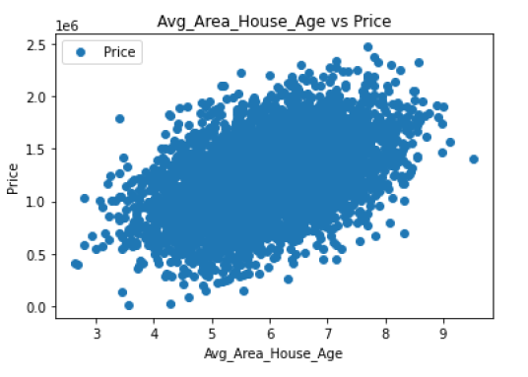
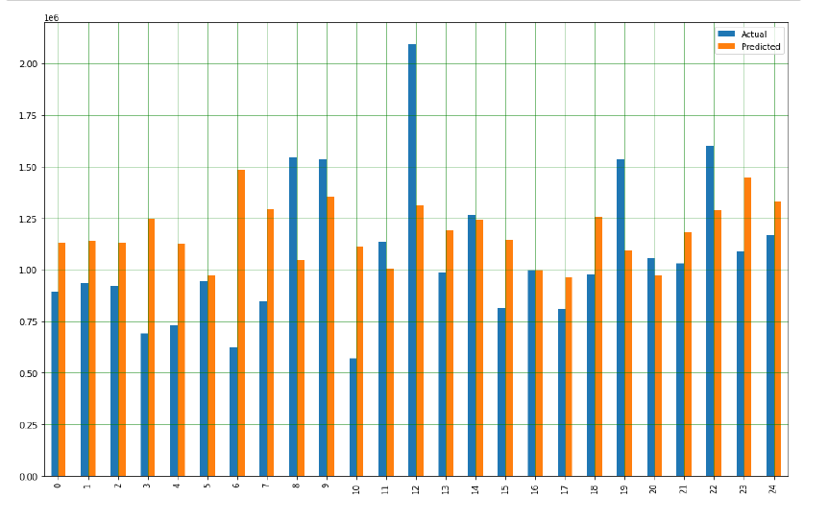
Case2: Avg Area House Age And Housing price
Based on “Avg Area House Age ” of the people linear regression performed to predict the value of houses.
Platform: Jupiter Notebook
Data Set: csv file
Language: python,( Panda, NumPy ).
Other Libraries:matplotlib.pyplot,seaborn, sklearn.model_selection,sklearn.linear_model,sklearn
X= Avg Area House Age
Y= houses Price
Training set =20% of the dataset
Testing set =80% of the dataset
Step 1: Trained the data set and get the intercept.
Step2: Use the test data set to predict the house prices.
Step3: Compare the Actual values with the predicted values
and plot a bar graph.

Slide 10
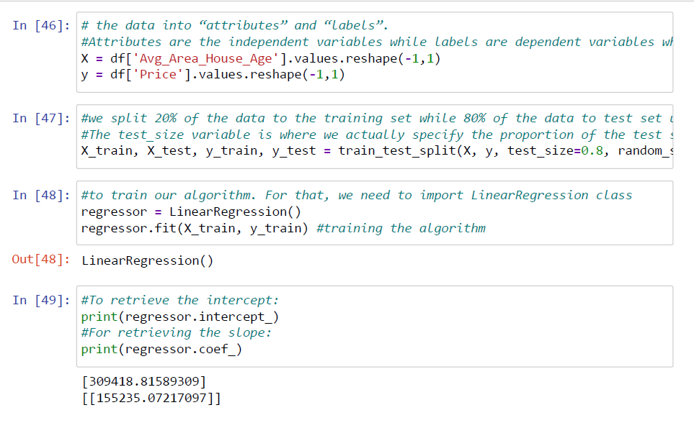
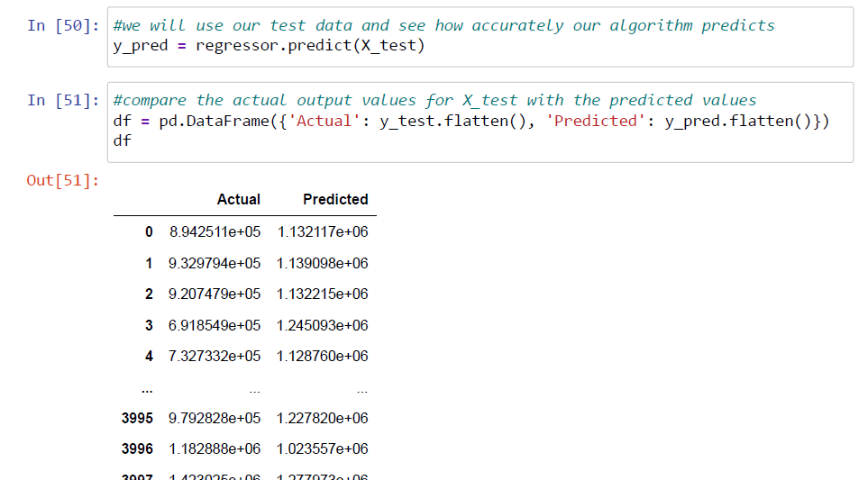
Case2: Avg Area House Age And Housing price

Slide 11
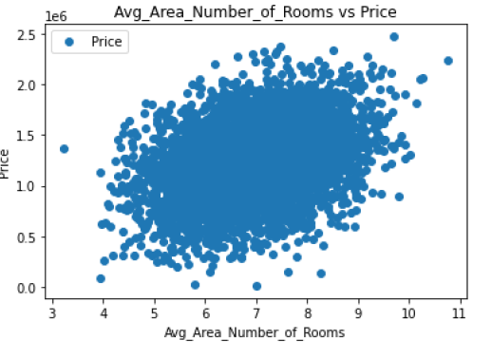
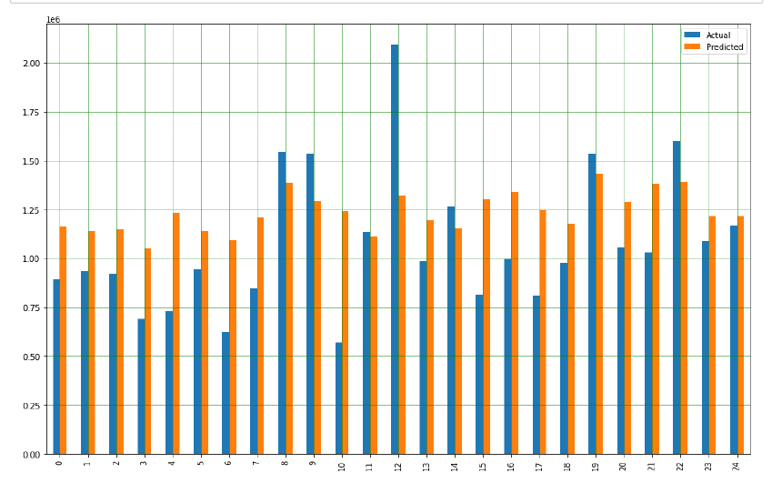
Case2: CAse3:“Avg Area Number of Rooms”And “Housing price”
Based on “Avg Area Number of Rooms” of the people linear regression performed to predict the value of houses.
Platform: Jupiter Notebook
Data Set: csv file
Language: python,( Panda, NumPy ).
Other Libraries:matplotlib.pyplot,seaborn, sklearn.model_selection,sklearn.linear_model,sklearn
X= Avg Area Number of Rooms
Y= houses Price
Training set =20% of the dataset
Testing set =80% of the dataset
Step 1: Trained the data set and get the intercept.
Step2: Use the test data set to predict the house prices.
Step3: Compare the Actual values with the predicted values and plot a bar graph.

Slide 12
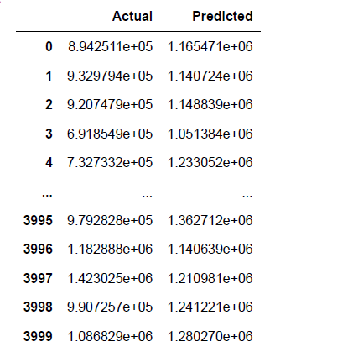
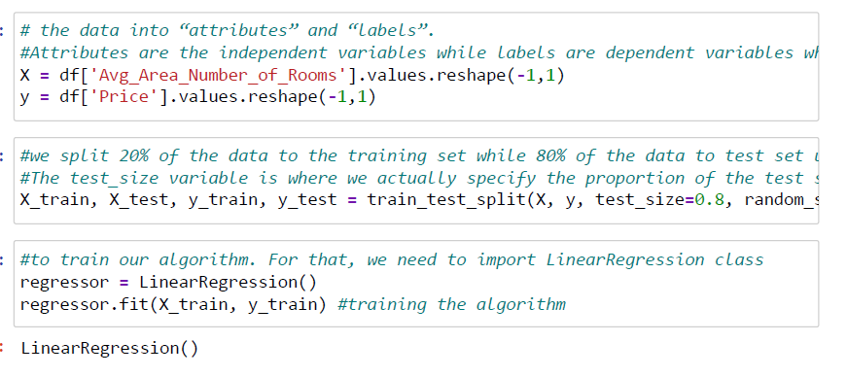
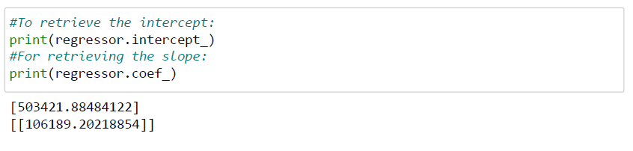
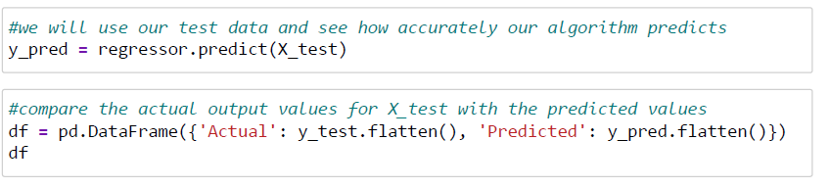
CAse3:“Avg Area Number of Rooms”And “Housing price”
Demo of the tool with inputs and outputs.

Slide 13
Outcomes
Goals: To predict the value of house prices.

Slide 14
References
Data Set Collected
Kaggel
Tools/Software
Microsoft Word, Power Point, Excel
Jupiter Notebook, Python, Panda, MATLAB, NumPy,
Material
Internet, Course Book, Python.org, W3 School, Notes, YouTube (codebasics )
Other Helps
NA

Slide 15
THANK YOU
Team: The Data Scientist
Divya Dongala
Pragati Gupta

